Slide 1
Use Case Report ELITE PARTY SERVICES
MCIS6333_002 DVP FA23
Team Number: 1 Team Name: DATAVANA
DVP Team Members: Anusha Pakkiru, Revanth Kumar Madasu
Date: November 18, 2023
Notes:
Instructions for this slide:
Edit the above slide to render it correct with regard to:
-Team number
-Team name
-Team member names
-Date
Leave the title of this slide as shown: Use Case Report
Do not remove or edit the Identification Stamp in the top left corner of the slide as it is necessary for the grading process.
Add any customization you desire in terms of design (as long as the Identification Stamp remains visible).

Slide 2
Client Name: HOORAY!
Offering: Elite Party Services
Notes:
Instructions for this slide:
Edit the above slide to render it correct with regard to:
-Client name
-Offering (what is the product or service that the client is wanting to get DVP results about?)
-Brand (if your use case has one; if not, just leave it as is: TBD (which stands for To Be Determined)
As discussed in CS10, all of the above information can be obtained from your Use Case Description .docx in your Bb Team File Exchange.
Add any customization you desire in terms of design.

Slide 3
Contents
Brief description of the Use Case
How does the likelihood of using elite party services change over time, and what factors contribute to both the peak and decrease in usage?
What factors contribute to the varied interest and seasonal popularity of elite party services?
How does education, internet use, and income relate to job opportunities and customer behavior?
How do party preferences differ among ethnic groups, particularly in the choice between Themed, Destination, and other party options?
What dietary preferences are observed in various ethnic groups and religions, with a focus on poultry and subsequent choices like vegetarianism?
What places in San Diego with good ratings on Google Maps offer services that could be useful for Elite party services' focus groups?
Summary of data insights most effective for decision making
Notes:
Recall our list of actionable use case requirements and objectives:
M2) User Behavior and Opinions Over Time.
M3) Composition of User Demographics, Interests, and Intentions.
M4) Distributions of User Age, Income, Usage Intent, and Purchase Intent.
M5) Demographic and other user-characteristic profile comparison of a) most viable, b) unsure, and c) most disinterested users.
M6) Revelatory relationships between user characteristics and intended behaviors.
M7) Possible data insights from geographical representations.
Instructions for this slide:
Replace all items on the above slide that are in red font with your team-specific content and remove the red font. Each team is required to have sections 1) and 8). Do not change the content of items 1 and 8.
Add any customization you desire in terms of design. ←This comment applies to the remainder of the slides below this point and will no longer be repeated.

Slide 4
1.Brief description of the Use Case
"Elite Party Services" entail an elevated approach to event planning, providing exclusive and premium offerings for diverse occasions. These services encompass personalized event coordination, carefully curated venue choices, and sophisticated solutions, ensuring a memorable and refined experience for clients seeking a higher level of celebration and hospitality.
Notes:
Instructions for this slide:
Each team is required to have section 1). Do not change the slide title of this slide for section 1.
As discussed in CS10, all of the Use Case information can be obtained from your Use Case Description .docx in your Bb Team File Exchange.

Slide 5
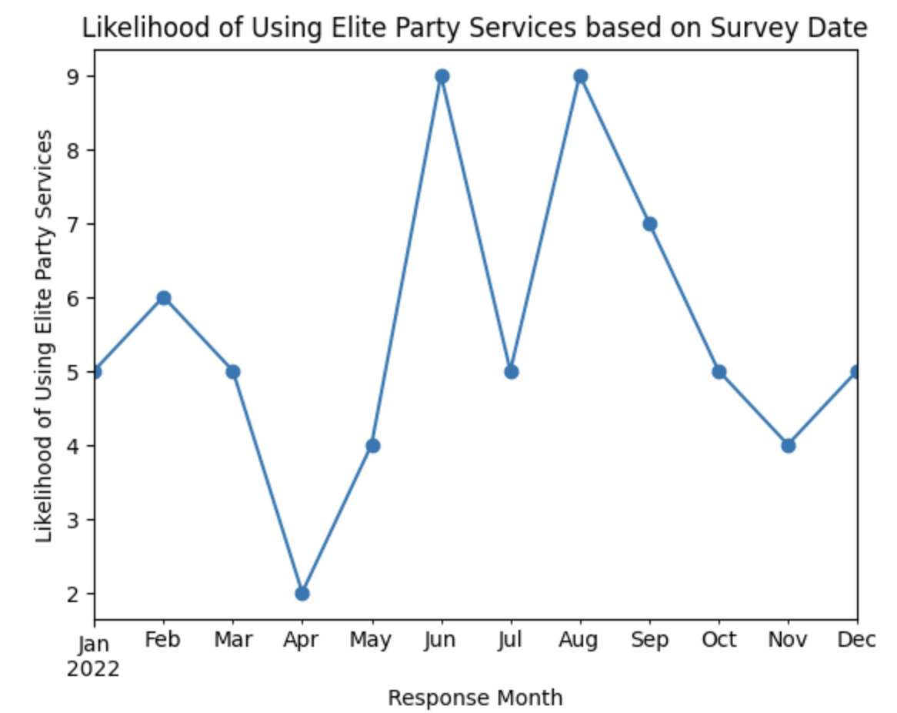
2. How does the likelihood of using elite party services change over time, and what factors contribute to both the peak and decrease in usage?
The data indicates a rise in the likelihood of utilizing elite party services from April to June, reaching its peak in June, and subsequently decreasing from August to November. The lowest likelihood is in April.

Slide 6
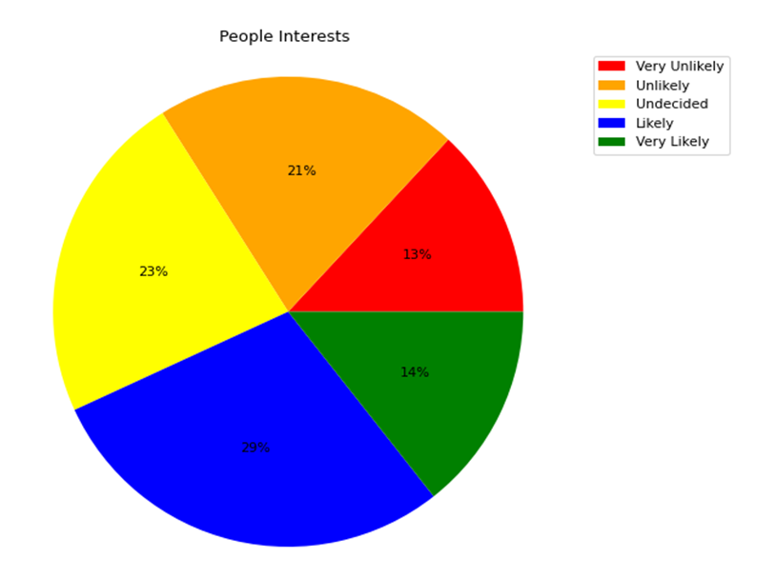
3. What factors contribute to the varied interest and seasonal popularity of elite party services?
This shows that the majority of consumers are likely to use Elite Party Services with 14% very likely and 29% likely contributing to 43% in total. Furthermore outnumbering those (13%) who are strongly uninterested.
Notes:
Recall our list of actionable use case requirements and objectives:
M2) User Behavior and Opinions Over Time.
M3) Composition of User Demographics, Interests, and Intentions.
M4) Distributions of User Age, Income, Usage Intent, and Purchase Intent.
M5) Demographic and other user-characteristic profile comparison of a) most viable, b) unsure, and c) most disinterested users.
M6) Revelatory relationships between user characteristics and intended behaviors.
M7) Possible data insights from geographical representations.
Instructions for this slide:
0) Keep this section numbered as section 2.
1) Replace the content in red font on the above slide with NOT-RED-FONTED team-created content based on a (your first) selection from the list of actionable use case requirements and objectives above. 2) Then insert the DVs that you used in your One-Page Report (OPR) that correspond to that use case objective item you selected.
3) Then insert your Data Insights that you used for each of those DVs. You can add more detail if you wish, since you have more room here in the PRES than you did in the OPR but be sure to match the minimum that you put in your OPR.
4) Add more slides if you need/want to but be careful not to lose the flow of your information and be sure not to mess up the numbering of the sections.

Slide 7
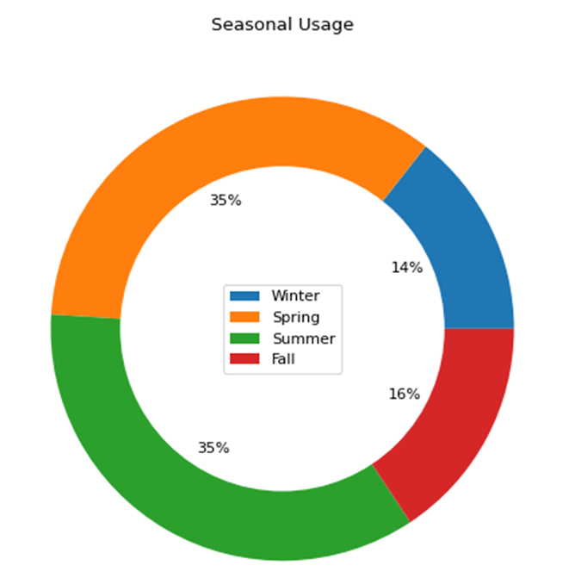
3. What factors contribute to the varied interest and seasonal popularity of elite party services?
In the spring and summer, 70% of people choose to use Elite Party Services. Winter is the least popular season, with 14%, while fall is in the center with 16%. This is most likely due to the fact that more outside activities take place in the spring and summer when the weather is good.

Slide 8
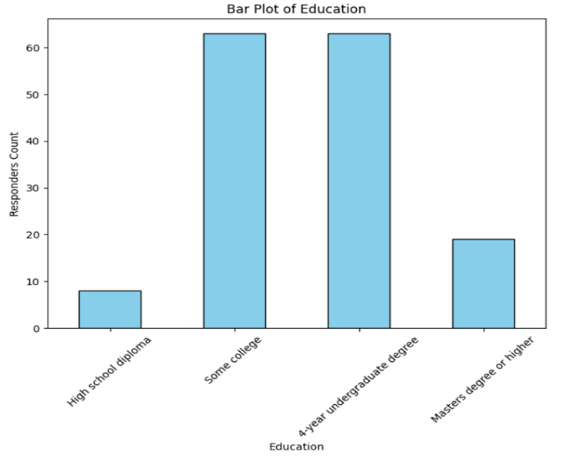
4. Distribution of responders based on education, income, age and internet usage
These findings indicate that majority of the target audience are in “Some College” and “4-year undergraduate degree” groups, where as “High school diploma“ group is lowest.

Slide 9
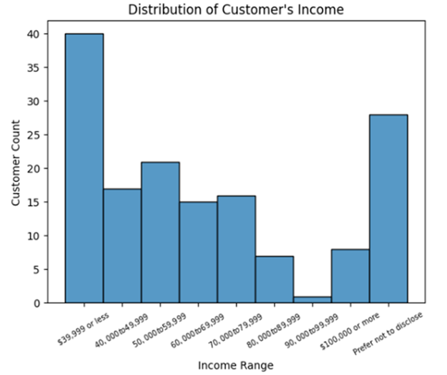
4. Distribution of responders based on education, income, age and internet usage
From the data visualizations under Distribution of customer’s income, income groups less than 39,999 is the majority with a count of 40 customers which is approximately 26% of total responders.

Slide 10
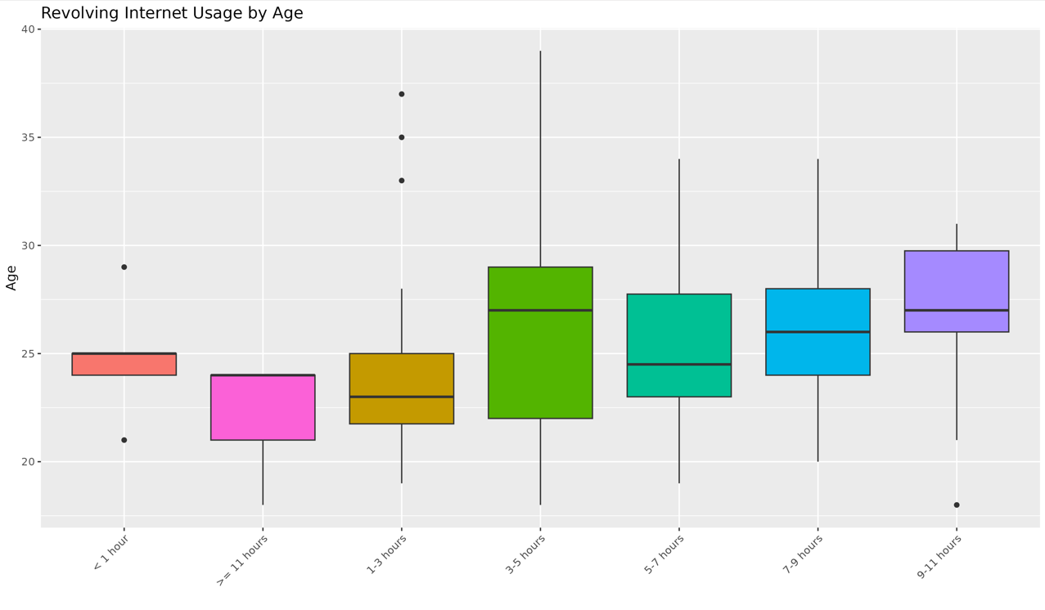
4. Distribution of responders based on education, income, age and internet usage
In the data visualization for the number of customers versus internet usage, the largest group consists of 55 customers who use the internet for 3 to 5 hours. This group is approximately 50% larger than the next highest group, which comprises customers using the internet for 5 to 7 hours.

Slide 11
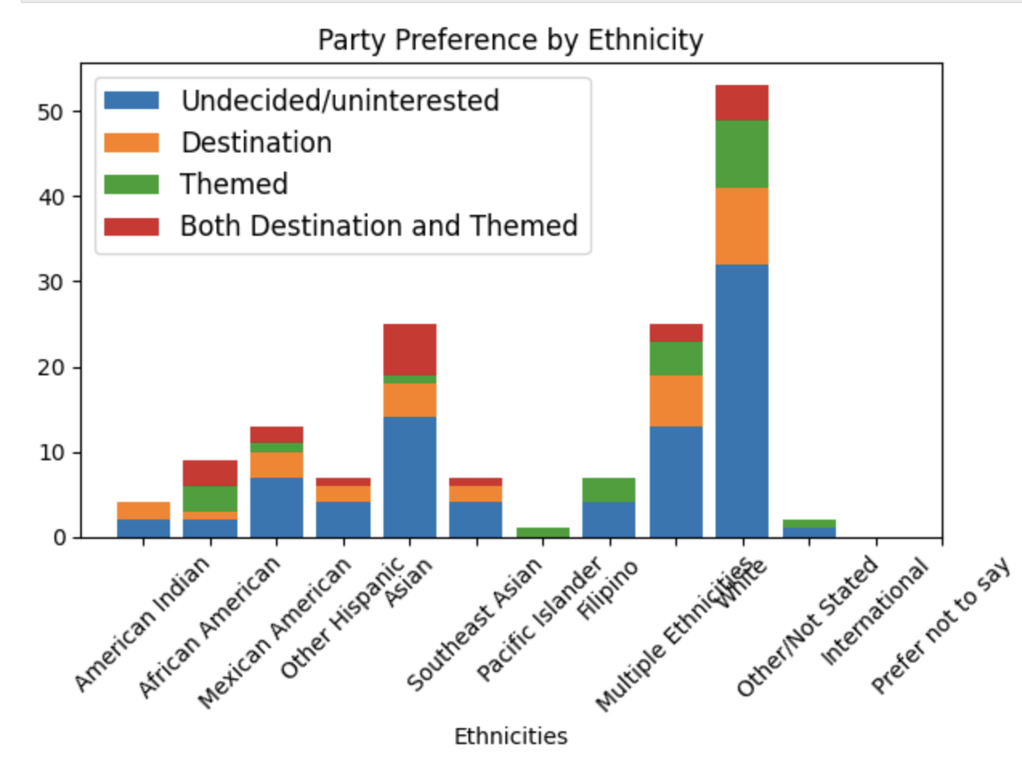
5. How do party preferences differ among ethnic groups, particularly in the choice between Themed, Destination, and other party options?
Note that in all ethnicity groups, the majority of responders are undecided on party preference.
Responders reported as “White” is the majority group who are equally interested in themed and destination parties.
Notes:
Recall our list of actionable use case requirements and objectives:
M2) User Behavior and Opinions Over Time.
M3) Composition of User Demographics, Interests, and Intentions.
M4) Distributions of User Age, Income, Usage Intent, and Purchase Intent.
M5) Demographic and other user-characteristic profile comparison of a) most viable, b) unsure, and c) most disinterested users.
M6) Revelatory relationships between user characteristics and intended behaviors.
M7) Possible data insights from geographical representations.
Instructions for this slide:
0) Keep this section numbered as section 4.
1) Replace the content in red font on the above slide with NOT-RED-FONTED team-created content based on a (your third) selection from the list of actionable use case requirements and objectives above. 2) Then insert the DVs that you used in your One-Page Report (OPR) that correspond to that use case objective item you selected.
3) Then insert your Data Insights that you used for each of those DVs. You can add more detail if you wish, since you have more room here in the PRES than you did in the OPR but be sure to match the minimum that you put in your OPR.
4) Add more slides if you need/want to but be careful not to lose the flow of your information and be sure not to mess up the numbering of the sections.

Slide 12
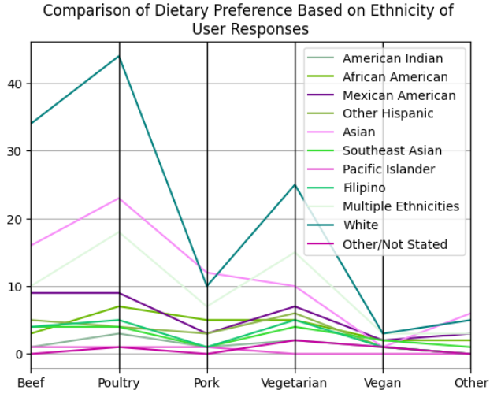
6.What dietary preferences are observed in various ethnic groups and religions, with a focus on poultry and subsequent choices like vegetarianism?
Poultry is the favorite choice of White, Asian, and Multiple Ethnicities, with vegetarian options being preferred by White and Multiple Ethnicities. Asians have a smaller proportion of vegetarians and vegans.
Notes:
Recall our list of actionable use case requirements and objectives:
M2) User Behavior and Opinions Over Time.
M3) Composition of User Demographics, Interests, and Intentions.
M4) Distributions of User Age, Income, Usage Intent, and Purchase Intent.
M5) Demographic and other user-characteristic profile comparison of a) most viable, b) unsure, and c) most disinterested users.
M6) Revelatory relationships between user characteristics and intended behaviors.
M7) Possible data insights from geographical representations.
Instructions for this slide:
0) Keep this section numbered as section 5.
1) Replace the content in red font on the above slide with NOT-RED-FONTED team-created content based on a (your fourth) selection from the list of actionable use case requirements and objectives above. 2) Then insert the DVs that you used in your One-Page Report (OPR) that correspond to that use case objective item you selected.
3) Then insert your Data Insights that you used for each of those DVs. You can add more detail if you wish, since you have more room here in the PRES than you did in the OPR but be sure to match the minimum that you put in your OPR.
4) Add more slides if you need/want to but be careful not to lose the flow of your information and be sure not to mess up the numbering of the sections.

Slide 13
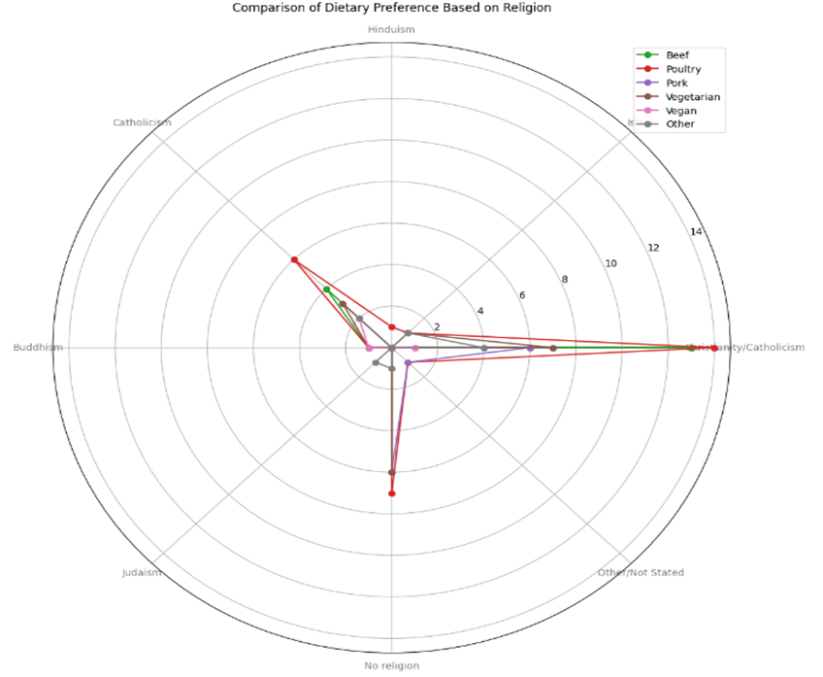
6.What dietary preferences are observed in various ethnic groups and religions, with a focus on poultry and subsequent choices like vegetarianism?
Christianity/Catholicism tops in poultry and beef preference among religions on the radar plot. Hinduism has the least meat preference, Buddhism opts for vegan only, and Judaism and Islam prefer other dietary choices.

Slide 14
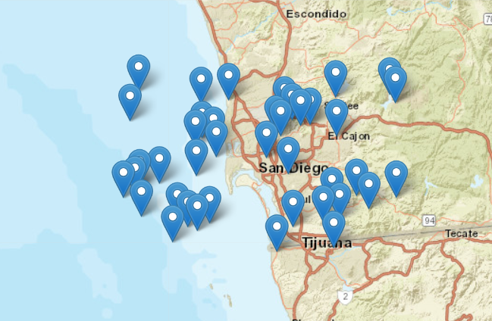
7. What places in San Diego with good ratings on Google Maps offer services that could be useful for Elite party services' focus groups?
Elite party services' focus groups are in San Diego, and there are nearby places like Taylor Research, Elite Lifestyle Management, Campaign Creators, Billy Gene Is Marketing Inc, and Elite Security & Staffing. These places offer services like market research, event planning, and security.
Notes:
Recall our list of actionable use case requirements and objectives:
M2) User Behavior and Opinions Over Time.
M3) Composition of User Demographics, Interests, and Intentions.
M4) Distributions of User Age, Income, Usage Intent, and Purchase Intent.
M5) Demographic and other user-characteristic profile comparison of a) most viable, b) unsure, and c) most disinterested users.
M6) Revelatory relationships between user characteristics and intended behaviors.
M7) Possible data insights from geographical representations.
Instructions for this slide:
0) Keep this section numbered as section 6.
1) Replace the content in red font on the above slide with NOT-RED-FONTED team-created content based on a (your fifth) selection from the list of actionable use case requirements and objectives above. 2) Then insert the DVs that you used in your One-Page Report (OPR) that correspond to that use case objective item you selected.
3) Then insert your Data Insights that you used for each of those DVs. You can add more detail if you wish, since you have more room here in the PRES than you did in the OPR but be sure to match the minimum that you put in your OPR.
4) Add more slides if you need/want to but be careful not to lose the flow of your information and be sure not to mess up the numbering of the sections.

Slide 15
8. Summary of Data Insights most effective for decision making
"Elite Party Services" provide first-rate event planning services with exclusive and premium options. We deliver a remarkable experience for customers looking for a classy celebration, from personalized coordination to magnificent venues.
The data indicates a rise in the likelihood of utilizing elite party services from April to June, reaching its peak in June, and subsequently decreasing from August to November. The lowest likelihood is in April.
The majority of consumers are likely to use Elite Party Services with 14% very likely and 29% likely contributing to 43% in total. Furthermore outnumbering those (13%) who are strongly uninterested.
In spring and summer, 70% use Elite Party Services. Winter is less popular at 14%, and fall is in the middle with 16%, likely due to more outdoor activities in good weather.
The majority of the target audience are in “Some College” and “4-year undergraduate degree” groups, where as “High school diploma“ group is lowest.
The majority of consumers (26% of total responders) have an income of less than $39,999.
Notes:
Each team is required to have section 8). Do not change the slide title of this slide for section 8.

Slide 16
In the customer versus internet usage chart, the biggest group is 55 customers using the internet for 3 to 5 hours, about 50% more than the next group with 5 to 7 hours.
The majority of White people favor themed parties, with the biggest number of undecided or apathetic votes. Asians favor both destination and themed gatherings.
Most ethnic groups, particularly White, Asian, and Multiracial, prefer poultry. Following poultry, the most popular option is vegetarian, with White and Multiple Ethnicities having the biggest preference. Asians are less interested in vegetarian and vegan options than other ethnic groups.
White, Asian, and Multiple Ethnicities prefer poultry, while White and Multiple Ethnicities lean towards vegetarian choices. Asians have fewer vegetarians and vegans.
In religions, Christianity/Catholicism prefers poultry and beef, Hinduism prefers less meat, Buddhism opts for vegan, and Judaism/Islam choose other diets.
Elite party services' focus groups are in San Diego, and surrounding businesses such as Taylor Research, Elite Lifestyle Management, Campaign Creators, Billy Gene Is Marketing Inc, and Elite Security & Staffing provide services.

Slide 17
End of the part of the Use Case Report wherein you are "speaking to the client".
Next comes the part of the Use Case Report wherein you are "speaking among us as a group of programmers".

Slide 18
Tasks to Show and Discuss to DVP Group
Discuss and showcase the Python code required for using the JupyterLite web-based environment to use your raw Use Case datasets to create a DV that shows how target customers for your use case vary with regard to their reported interest in or intentions for the client's offering based on some demographic variable.
Discuss and showcase the R code required for using the Posit Cloud RStudio Cloud web-based environment to use your raw Use Case datasets to create a DV that shows how target customers for your use case vary with regard to their reported interest in or intentions for the client's offering based on some demographic variable.
Notes:
Do not make any changes to this slide.
Instructions for this slide:
0) Do not delete or change any of the text content on this slide.
1) The pre-filled text contents on this slide will serve as a guide to this part of the presentation.
(Examples: Amount willing to pay based on income level; Agreement level with some motivational usage factor based on ethnicity; Likelihood of using the product or service based on education level; Usage scenarios (such as day or week or time of day) based on some demographic variable.)

Slide 19
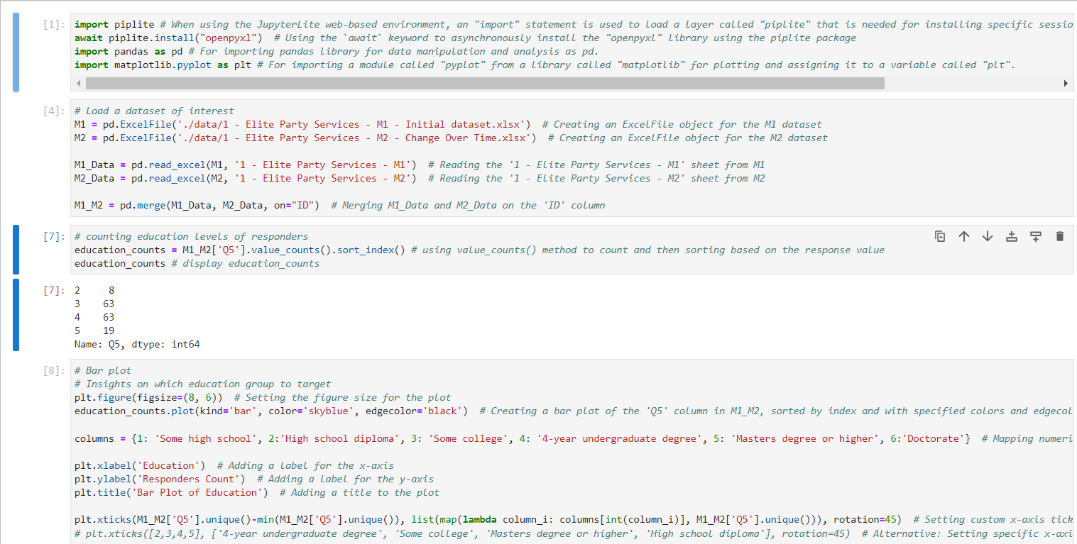
1. Discuss and showcase the Python code required for using the JupyterLite web-based environment to use your raw Use Case datasets to create a DV that shows how target customers for your use case vary with regard to their reported interest in or intentions for the client's offering based on some demographic variable.
Notes:
Instructions for this slide:
0) Do not delete or change the top-most pre-filled text box, which repeats the details of the required task 1.
1) Insert image (code screenshots) to satisfy the task. Add as many additional slides as you need while ensuring that the viewer/reader does not get lost as to what you are talking about. One way to ensure for that is to simply maintain that top-most pre-filled text box, which repeats the details of the required task on each additional slide that you need for it.

Slide 20
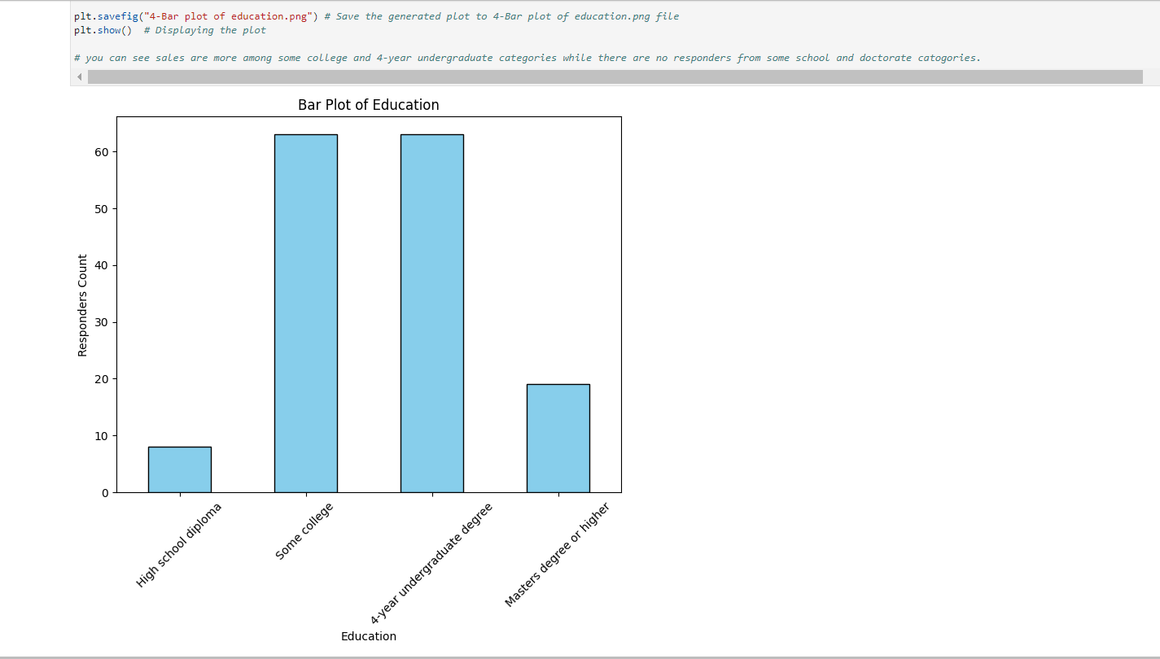

Slide 21
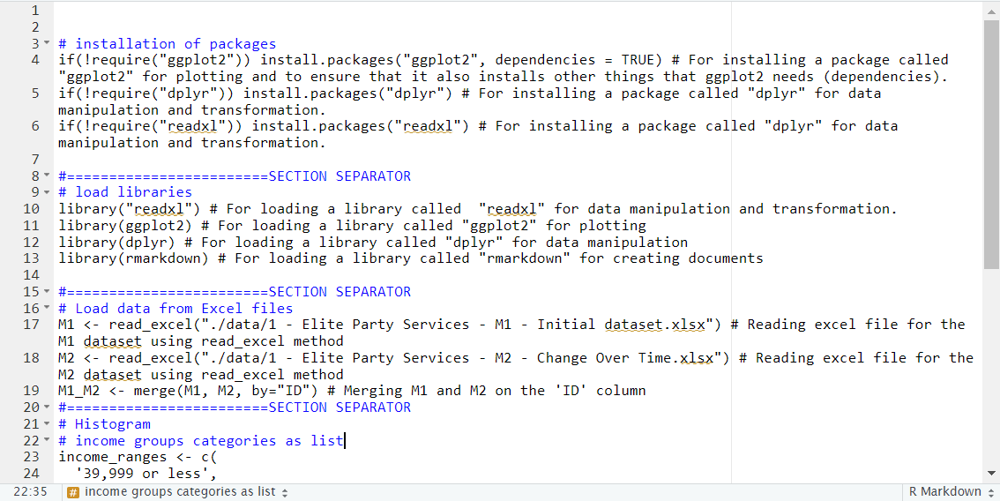
2. Discuss and showcase the R code required for using the Posit Cloud RStudio Cloud web-based environment to use your raw Use Case datasets to create a DV that shows how target customers for your use case vary with regard to their reported interest in or intentions for the client's offering based on some demographic variable.
Notes:
Instructions for this slide:
0) Do not delete or change the top-most pre-filled text box, which repeats the details of the required task 2.
1) Insert image (code screenshots) to satisfy the task. Add as many additional slides as you need while ensuring that the viewer/reader does not get lost as to what you are talking about. One way to ensure for that is to simply maintain that top-most pre-filled text box, which repeats the details of the required task on each additional slide that you need for it.

Slide 22
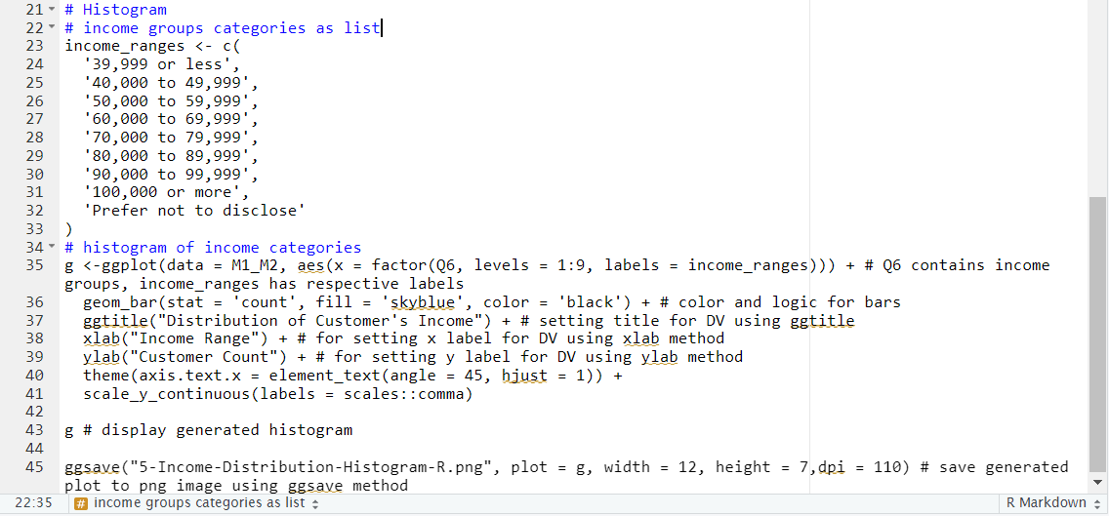

Slide 23
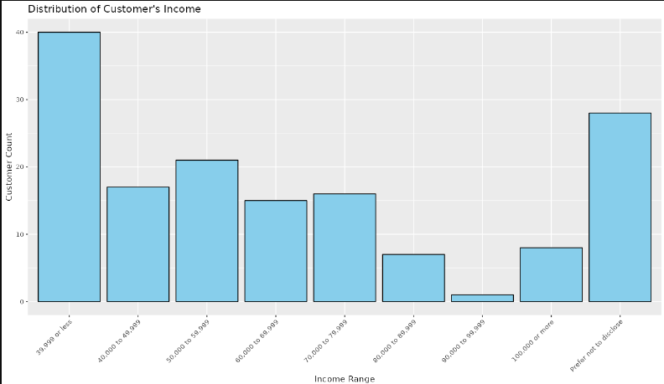

Slide 24
End of file.
MCIS6333_002 DVP FA23
Notes:
Instructions for this slide:
0) Do not delete or change this slide.

